Slide 1
Bad Apples: The Peer Effects of violence
Sidra Ahmad
Notes:
Good afternoon, everyone. My name is Sidra, and I’m here to present to you my International Relations thesis, “Bad Apples: The Peer Effects of Violence.”

Slide 2
Q: Does violence spread within groups of diverse individuals in a common institutional setting?
A: Yes.*
*Violent behavior spreads from the group to each of its members but not between members. Violent culture doesn’t spread at all.
Notes:
The broad question I seek to answer is whether violence spreads within groups of diverse individuals in a common institutional setting, and my results show that it does—but with a caveat: violent behavior transfers from the group to each member but not from member to member, and violent culture doesn’t spread at all.

Slide 3
Q: Why does this matter? A: Membership in institutions alters states’ behavior—positively¹ and negatively²—through the diffusion of norms of behavior. What happens to individual political actors?
¹ (Mansfield and Pevehouse 2008)
² (Hafner-Burton and Montgomery 2008)
Notes:
This question is worthy of examination because existing literature demonstrates that nations modify their actions as a consequence of membership in institutions such as international organizations and trade agreements due to the diffusion of norms of behavior. My work examines this phenomenon at the individual level, but there’s a twist. Instead of studying courts or committees, I will be looking at European soccer leagues because they are composed of multi-cultural teams and operate under the overarching framework of FIFA’s Laws of the Game.

Slide 4
Literature and Theory
Notes:
At this point, I would like to present an overview of the literature and theories that inform my subsequent analysis.

Slide 5
Lasting Impact of Civil War
Learning Mechanisms
Civil war disturbs the status quo and legitimizes violence; individuals are socialized into aggression
Miguel et al. (2011): Higher incidence of conflict in a player’s home country → more yellow/red cards he receives
Peer Effects
Gould and Kaplan (2008): A baseball player’s performance, especially with regard to power hitting, significantly improves after being on the same team with Canseco
Guryan et al. (2009): No relationship between a golfer’s score and the ability, relative or absolute, of his “groupmates”
Social Learning Theory (Bandura 1971): People learn through direct experience and observation
Mirror Neurons: Fire during observation and execution; believed to be responsible for imitation
Notes:
Let’s start with peer effects, which are the impact of the influences that individuals exert on one another. Carrell et al. (2008) studied cheating in U.S. military academies and found that when cheating is more prevalent, it increases the likelihood an individual student will cheat. Moving on to professional sports, Gould and Kaplan (2008) investigate at the baseball players former outfielder and admitted steroid user Jose Canseco accused of juicing, and they found that those athletes had improved performance, specifically power hitting, after playing on the same team with Canseco. This insinuates that they indeed used performance-enhancing drugs, and the authors state that the strong financial incentives in this situation can compel individuals to overcome social and moral barriers and engage in rule-breaking behavior. Finally, Guryan et al. (2009) evaluate the presence of peer effects in the initial, randomized rounds in Professional Golfers’ Association competitions, and their results showed no relationship between a golfer’s score and ability of the other golfers in their groups. Their conclusion is that at such a high level of talent, individuals are skilled enough to ignore external influences. This suggests that we shouldn’t see any peer effects, but golf isn’t a team sport, and soccer is, so take this with a grain of salt.
European soccer teams are composed of players from all around the world, and many of them come from nations that have a long history of internal armed conflict. We know that civil war disturbs the status quo and legitimizes aggression, essentially creating a culture of violence into which individuals are socialized and unable to shake off. According to Miguel, the esteemed Professor Satyanath, and Saiegh, there is a positive relationship between the prevalence of civil war in a player’s home country and the number of yellow and red cards he receives. Thus, it’s clear that a person’s own exposure to civil war affects his behavior, but what about the behavior of his teammates? And what are the mechanisms by which a peer effect would be exerted?
Psychologist Albert Bandura’s social learning theory states that people acquire knowledge through both direct experience and observation and subsequently modify their own actions. We see this at play in Ingersoll et al.’s (2013) paper in which they found that more diverse teams perform better than those that are less so because their players are learning region-specific tactics from one another. Finally, discussing human behavior often opens the door for the nature vs. nurture debate, but the presence of mirror neurons, which fire during the observation and execution of a motor action and are thought to be the biological explanation for imitation, seems to suggest that we are wired to learn from each other.

Slide 6
Hypotheses
Notes:
This brings us to my hypotheses.

Slide 7
H₅
H₂: Team I’s aggregate violent behavior exerts a peer effect on player i’s behavior.
H₃: Player j’s exposure to civil war exerts a peer effect on player i’s behavior.
H₁: Team I’s aggregate exposure to civil war exerts a peer effect on player i’s behavior.
H₄: Player j’s violent behavior exerts a peer effect on player i’s behavior.
H₅: Peer effects exerted by player j will be stronger than peer effects exerted by team I.
H₁
H₃
H₂
H₄
Team I
Player j
Civil War Exposure
Violent Behavior
Notes:
I posit that peer effects are being exerted on player i’s behavior two levels—team I to player i and player j (a teammate) to player i—and in two dimensions: civil war exposure, which embodies violent culture, and violent behavior. I also posit that the peer effects exerted by player j will be stronger than those exerted by team I because the “treatment” is more targeted and concentrated.

Slide 8
Data, Variables, and Methodology
Notes:
And now, I’ll present an overview of my data, variables, and methodology.

Slide 9






“Civil War Exposure and Violence” (Miguel et al. 2011)
Five national leagues: England, France, Germany, Italy, and Spain
One supra-national league: Champions League
Two seasons: 2004-05, 2005-06
Compiled from ESPN Soccernet, UCDP/PRIO Armed Conflict Data, Worldwide Governance Indicators (World Bank), Football Manager, 2005 and World Soccer Manager, 2006
Modifications
Dyads composed of players i and j
Spatial effect variables representing the aggregate influence of team I’s civil war exposure and behavior
Team I control variables: mean metrics among players on the team
Notes:
I use the data set from Miguel et al.’s (2011) paper “Civil War Exposure and Violence.” It is comprised of observations from the English, French, German, Italian, Spanish, and Champions leagues over the 2004-05 and 2005-06 seasons. The sources of the data are diverse, including ESPN Soccernet, UCDP/PRIO Armed Conflict Data, the World Bank, and two computer games. The data set was modified to meet the needs of my inquiry. First of all, I generated dyads composed of player i and each of his teammates. Then, I used Stata command spmon to create spatial effect variables representing team I’s aggregate civil war exposure and behavior. Finally, I derived team controls from the individual control variables by calculating the mean value across all the players on a team.

Slide 10
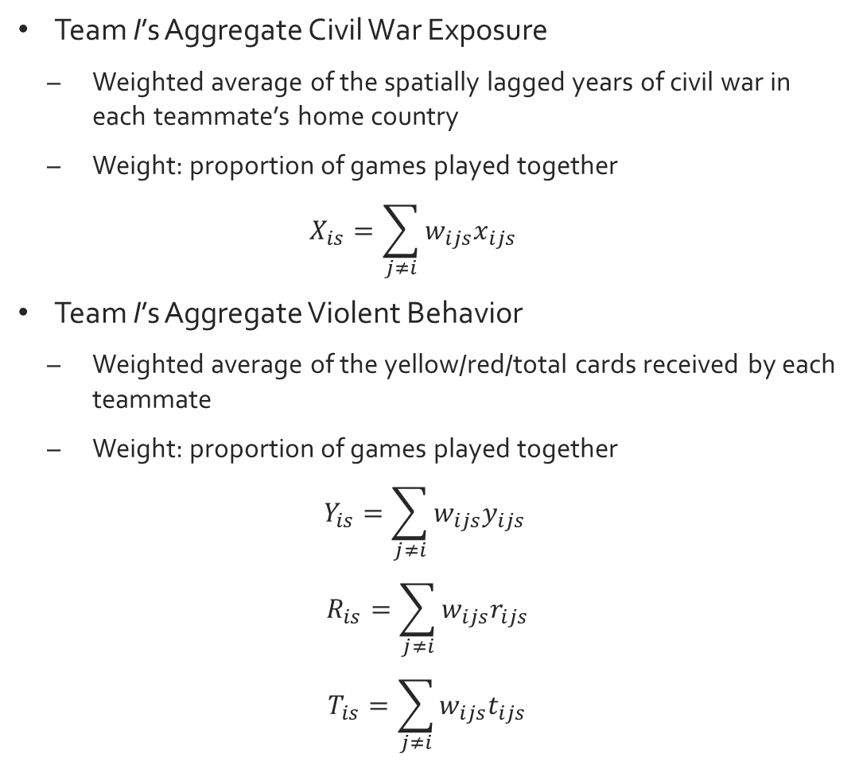
Spatial Effect Variables
Team I’s Aggregate Civil War Exposure
Weighted average of the spatially lagged years of civil war in each teammate’s home country
Weight: proportion of games played together
$$X_{is}=\sum_{j≠i}{w_{ijs}x_{ijs}}$$
Team I’s Aggregate Violent Behavior
Weighted average of the yellow/red/total cards received by each teammate
Weight: proportion of games played together
$$Y_{is}=\sum_{j≠i}{w_{ijs}y_{ijs}}$$
$$R_{is}=\sum_{j≠i}{w_{ijs}r_{ijs}}$$
$$T_{is}=\sum_{j≠i}{w_{ijs}t_{ijs}}$$
i = player of analysis; j = i’s teammate; s = season; w = weight; x = years of civil war in player’s home country; y = yellow cards; r = red cards, t = total cards
Notes:
Since I’m interested in how interactions between players shape the actions of the player of interest, i, this study requires spatial statistical analysis, which measures the impact of proximity on outcomes, and surprise, surprise, spatial effect variables. Team I’s aggregate civil war exposure is the weighted average of the spatially lagged years of civil war in the native country of each of player i’s teammates. The weight is the proportion of games played together because I expect that the more time players spend on the pitch together, the stronger the peer effect. In the case of team I’s aggregate violent behavior, the weight remains the same, but the yellow, red, and total cards received by each of player i’s teammates are spatially lagged.

Slide 11
Dependent (player i’s behavior)
Yellow, Red, and Total Cards Received
Independent
Team I’s Aggregate Civil War Exposure
Team I’s Aggregate Behavior
Player j’s Civil War Exposure
Player j’s Aggregate Behavior
Controls
Field Position
Number of Games as a Starter
Number of Games as a Substitute
Age
Player Quality
Goals Scored
Ln(Transfer Fee)
Rule of Law in Player i’s Home Country
Fixed Effects: League, World Region
Notes:
My dependent variables are the yellow, red, and total cards received by player i. My independent variables were already mentioned in my hypotheses. Like Miguel et al., I control for factors that could have an effect on player i’’s fouls, including his position, the number of games in which he’s a starter or substitute, his age, quality (goals scored and log of transfer fee), and the rule of law in his home country. League and world region fixed effects are included to account for differences in the way fouls are called across teams and the possibility of racial discrimination by referees, respectively.

Slide 12
Methodology
Team-to-Player Peer Effects
Statistical analysis using monadic spatial effect variables
Player-to-Player Peer Effects
Statistical analysis within dyads composed of players i and j
Negative binomial regression
Standard errors clustered by player i’s home country
Robustness Check: Zero-inflated negative binomial regression
Notes:
As alluded to earlier, I use spatial statistical analysis to determine the existence of team-to-player peer effects. For player-to-player peer effects, a different empirical strategy is employed. In dyads composed of player i and each of his teammates, player i’s cards are regressed on the years of civil war in his teammate j’s native country and the number of cards j receives.
Since cards are count variables, I use negative binomial regression as my estimator. Standard errors are clustered by player i’s native country. Zero-inflated negative binomial regression is used in the robustness check to account for excessive zeros.

Slide 13
Results
Notes:
And now the moment you’ve all been waiting for, results.

Slide 14
H₅
H₁
H₃
H₂
H₄
Team I
Player j
Civil War Exposure
Violent Behavior
Notes:
As you can see, I am unable to reject the null hypothesis in favor of hypothesis 1 (team I’s aggregate civil war exposure), and hypotheses 3-5, which dealt with the peer effect of player j, so in the interest of time, I will discuss my findings in the model which was significant, namely team I’s aggregate violent behavior.

Slide 15
Table 1: The Effect of Team I’s Aggregate Violent Behavior on Player i’s Behavior
Negative binomial regression
Standard errors in parentheses
Significance at 90% (*), 95% (**), and 99% (***) confidence levels
H₂: Team I’s aggregate violent behavior exerts a peer effect on player i’s behavior.
 | (1) | (2) | (3) | (4) | (5) | (6)
 | Yellow Cards | Yellow Cards | Red Cards | Red Cards | Total Cards | Total Cards
VARIABLES | Individual Controls | Team Controls | Individual Controls | Team Controls | Individual Controls | Team Controls
Independent
Spatially Lagged Yellow Cards Received by Player j, Weight = Games Played Together | 0.155*** (0.0145) | 0.624*** (0.0203)
Spatially Lagged Red Cards Received by Player j, Weight = Games Played Together |  |  | 0.427** (0.217) | 1.570*** (0.183)
Spatially Lagged Total Cards Received by Player j, Weight = Games Played Together |  |  |  |  | 0.154*** (0.0124) | 0.586*** (0.0178)
Controls
Years of Civil War in Player i’s Home Country | 0.00800*** (0.00284) | 0.00827* (0.00426) | 0.0150** (0.00664) | 0.0173*** (0.00629) | 0.00839*** (0.00290) | 0.00861** (0.00425)
Player i Characteristics | Yes | No | Yes | No | Yes | No
Team I Characteristics | No | Yes | No | Yes | No | Yes
Constant | -3.268*** | -1.225* | -5.308*** | -3.283** | -3.250*** | -1.347**
 | (0.337) | (0.697) | (0.618) | (1.621) | (0.319) | (0.636)
Observations | 5,064 | 5,386 | 5,064 | 5,386 | 5,064 | 5,386
League Fixed Effects | Yes | Yes | Yes | Yes | Yes | Yes
World Region Fixed Effects | Yes | Yes | Yes | Yes | Yes | Yes
Notes:
Irrespective of the card classification or control variables, the coefficient team I’s aggregate civil war exposure is positive and statistically significant at the 99% confidence level in all specifications excluding Red Cards with Individual Controls, which is significant at the 95% confidence level, and this can be attributed to the fact that there are much fewer red cards (814) than yellow cards (12,683). I’d also like to point out that a player’s own civil war exposure, the independent variable in Miguel et al. continues to remain significant, but it’s coefficients are much lower than those of the spatial effect variables. Since negative binomial regression is a non-linear estimator, I can’t make straightforward rise/run interpretations of the coefficients. For that, I turn to the incidence rate ratios—or IRR.

Slide 16
Table 2: The Effect of Team I’s Aggregate Violent Behavior on Player i’s Behavior
– Incidence Rate Ratios
Negative binomial regression
Z-value in parentheses
Significance at 90% (*), 95% (**), and 99% (***) confidence levels
 | (1) | (2) | (3) | (4) | (5) | (6)
 | Yellow Cards | Yellow Cards | Red Cards | Red Cards | Total Cards | Total Cards
VARIABLES | Individual Controls | Team Controls | Individual Controls | Team Controls | Individual Controls | Team Controls
Independent
Spatially Lagged Yellow Cards Received by Player j, Weight = Games Played Together | 1.168 (10.69)** | 1.866 (30.71)**
Spatially Lagged Red Cards Received by Player j, Weight = Games Played Together |  |  | 1.533 (1.96)* | 4.805 (8.58)**
Spatially Lagged Total Cards Received by Player j, Weight = Games Played Together |  |  |  |  | 1.167 (12.44)** | 1.797 (33.01)**
Controls
Years of Civil War in Player i’s Home Country | 1.008 | 1.008 | 1.015 | 1.017 | 1.008 | 1.009
 | (2.81)** | (1.94) | (2.26)* | (2.74)** | (2.90)** | (2.03)*
Player i Characteristics | Yes | No | Yes | No | Yes | No
Team I Characteristics | No | Yes | No | Yes | No | Yes
Observations | 5,064 | 5,386 | 5,064 | 5,386 | 5,064 | 5,386
League Fixed Effects | Yes | Yes | Yes | Yes | Yes | Yes
World Region Fixed Effects | Yes | Yes | Yes | Yes | Yes | Yes
Notes:
The incidence rate ratios show us the multiplicative effect of the explanatory variables on the dependent variables. In the case of Yellow Cards, Individual Controls, there is a nearly 17% increase in the yellow cards received by player i as a consequence of the aggregate influence of his team’s behavior. Controlling for team I characteristics, there is an approximately 86% increase. Red Cards, Team controls has the largest IRR, 4.805, indicating an increase by a factor of almost 5, but once again, the red card results should be taken with a grain of salt due to the relatively small count. The total card IRRs are similar to the those of the yellow cards. The years of civil war in player i’s home country only drives about one percent of the increase in cards.

Slide 17
Table 3: The Effect of Team I’s Aggregate Violent Behavior on Player i’s Behavior
– Robustness Check*
Zero-inflated negative binomial regression
Standard errors in parentheses
Significance at 90% (*), 95% (**), and 99% (***) confidence levels
*The red card models did not converge.
 | (1) | (2) | (3) | (4)
 | Yellow Cards | Yellow Cards | Total Cards | Total Cards
VARIABLES | Individual Controls | Team Controls | Individual Controls | Team Controls
Independent
Spatially Lagged Yellow Cards Received by Player j, Weight = Games Played Together | 0.0738*** (0.0105) | 0.268*** (0.0116)
Spatially Lagged Total Cards Received by Player j, Weight = Games Played Together |  |  | 0.0765*** (0.00876) | 0.257*** (0.0118)
Controls
Years of Civil War in Player i’s Home Country | 0.00529** (0.00226) | 0.00546* (0.00304) | 0.00567** (0.00222) | 0.00591* (0.00312)
Player i Characteristics | Yes | No | Yes | No
Team I Characteristics | No | Yes | No | Yes
Constant | -0.968*** | 0.926** | -1.028*** | 0.866**
 | (0.192) | (0.398) | (0.202) | (0.442)
Observations | 5,064 | 5,386 | 5,064 | 5,386
League Fixed Effects | Yes | Yes | Yes | Yes
World Region Fixed Effects | Yes | Yes | Yes | Yes
Notes:
The yellow and total card results are robust to switching the estimator to zero-inflated negative binomial regression, but I was unable to determine the robustness of the red card specifications because the models did not converge in spite of varying combinations of control variables and fixed effects.

Slide 18
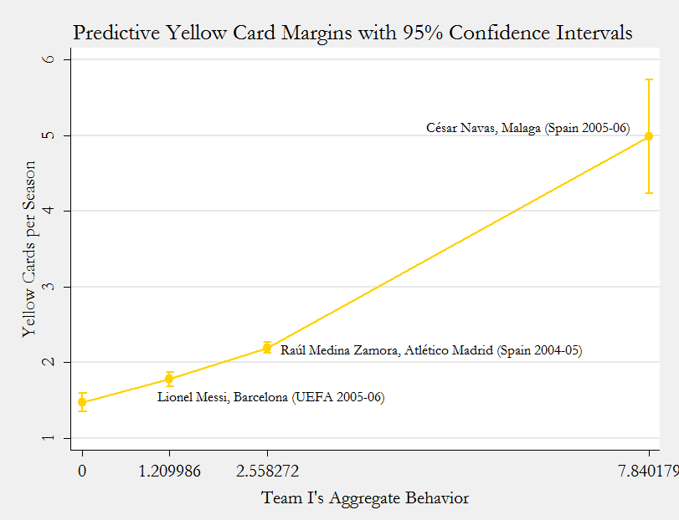
The Predicted Effect of Team I’s Aggregate Behavior on Yellow Cards Received by an Average Player
Notes:
Here is a margins plot with 95% confidence intervals for the predicted number of yellow cards received by an average player in the data set given the specified spatial effect being exerted upon him. In other words, if the average player from my data set replaced Lionel Messi on Barcelona’s Champions League-winning squad in the 2005-06 season, he’d be expected to receive almost two yellow cards. On the other hand, the average player replacing César Navas on the 2005-06 Malaga team in the Spanish Primera Division is expected to be issued approximately five yellow cards.

Slide 19
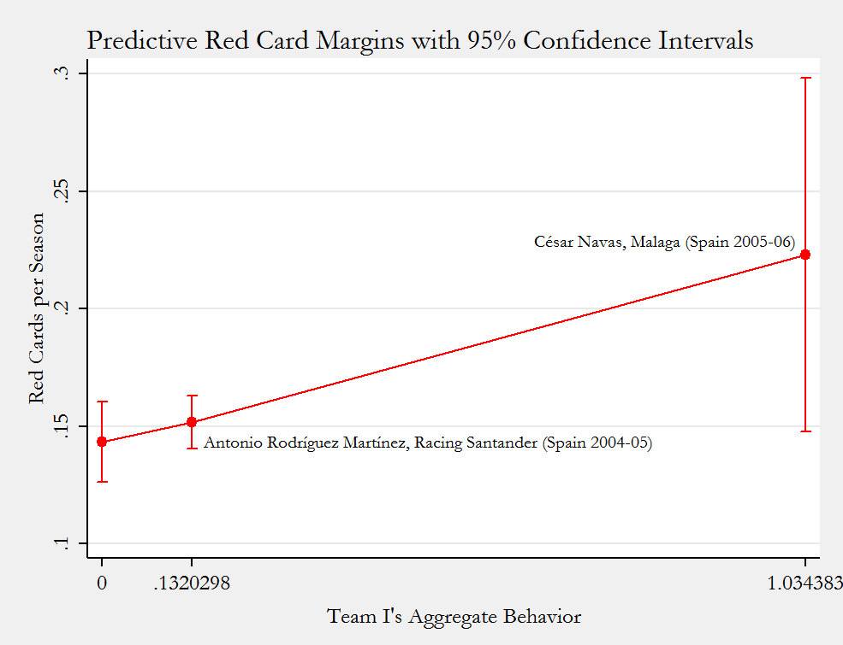
The Predicted Effect of Team I’s Aggregate Behavior on Red Cards Received by an Average Player
Notes:
Similarly, here is a predicted red card margins plot with 95% confidence levels.

Slide 20
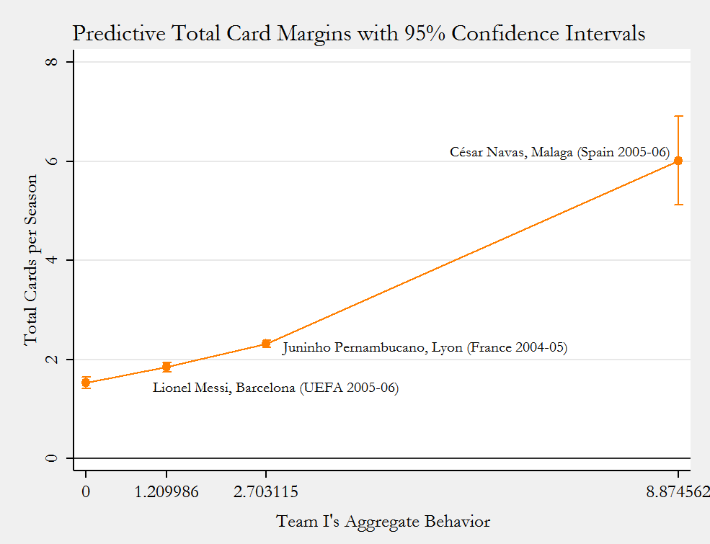
The Predicted Effect of Team I’s Aggregate Behavior on Total Cards Received by an Average Player
Notes:
And here is the corresponding margins plot for total cards.

Slide 21

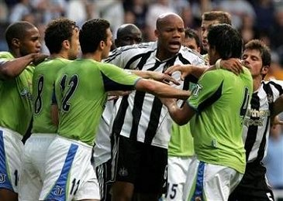
DEPORTIVO LA CORUÑA
SPANISH PRIMERA DIVISION
2005-2006
Player | Yellow Cards | Team I’s Aggregate Behavior
Aldo Duscher | 16 | 5.249
Pedro Alvarez Munitis | 12 | 5.587
Juan Capdevila | 10 | 5.742
Jorge Andrade | 9 | 4.523
Delgado Manuel Juanma | 8 | 5.105
Julian De Guzmán | 8 | 5.00655
Manuel Pablo | 7 | 5.879
Sergio | 7 | 5.958
Diego Tristán | 6 | 6.0433
Fabricio Coloccini | 6 | 5.507
Sanchez Victor | 5 | 5.0800
Berenguel Hector | 3 | 4.552
César | 3 | 3.613
Jose Francisco Molina | 3 | 6.259
Lionel Scaloni | 3 | 4.552
Enrique Romero | 2 | 5.148
Iglesias Iago | 2 | 4.103
Javier Arizmendi | 2 | 4.861
Rubén | 2 | 5.576
Francisco Jiménez Tejada | 1 | 4.310
Iván Carril | 1 | 4.0636
Jeronimo Cabrera Momo | 1 | 3.301
Sebastián Taborda | 1 | 3.970
Juan Carlos Valerón | 0 | 5.277
Pablo Amo | 0 | 2.849
Senel | 0 | 3.230
Notes:
At this point, I’d like to present a real-world illustration of the impact of a team’s aggregate behavior on the yellow cards each of its players receives. Aldo Duscher, an Argentine midfielder on Deportivo La Coruña has the distinct honor of obtaining the most per-season yellow cards, 16, in my data set. The spatial effect exerted upon him is about 5.3, and if you look at teammates, a sizeable number of them have relatively large yellow card and spatial effect values.

Slide 22
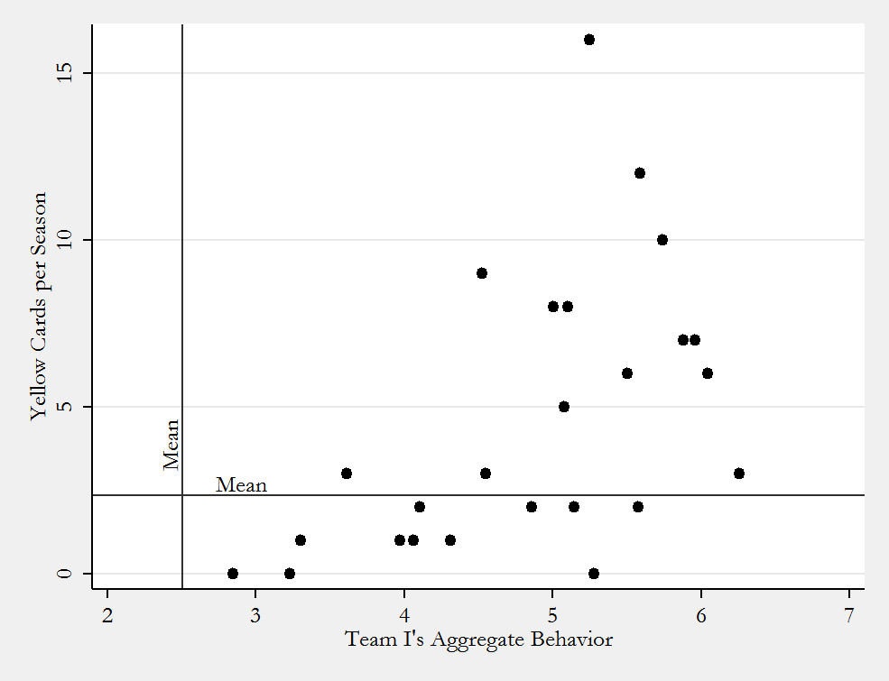
The Effect of Deportivo La Coruña’s Aggregate Behavior on Yellow Cards Received by Each of Its Players
Notes:
A closer look reveals that all of them have above-average spatial effects being exerted upon them, and most of them lie above the average number of per-season yellow cards received. Those who are below the yellow card mean are likely goalies/defenders or players who are often substitutes rather than starters.

Slide 23
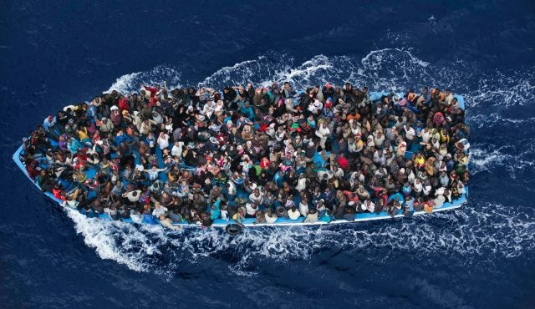
Conclusions
Violent culture does not spread among individuals.
Violent behavior spreads from groups to individuals.
Why not person-to-person? Incorrect empirical strategy?
Real world implication: European refugee crisis
Notes:
To recap, violent culture doesn’t spread among individuals, but violent behavior spreads from groups to individuals. The lack of significant findings for person-to-person peer effects of behavior is suspicious to me. After all, if there are group-to-individual peer effects, we should expect the diffusion of behavior between individuals. In my opinion, the empirical strategy I employed was inadequate, and I should have performed spatial statistical analysis using directed dyads, comparing the one-on-one peer effect between to players to the peer effects within all the other pairs on the team.
Bringing this back to current affairs, the peer effects of violence are salient to the current refugee crisis in Europe as one of the arguments made by far-right groups is that admitting refugees will alter the prevailing culture because they come from a conflict-ravaged region. However, this assertion seems to be unfounded because culture does not diffuse, whereas behavior does.

